Slide 1
SECTOR HISTORY
Training Guide

Slide 2
Course Objectives:
Increase awareness of SECTOR features
Students will become aware of the automated SECTOR History feature and how to access records
Students will become familiar with the SECTOR Warning and learn:
How to create a warning
How to resolve a warning they created
How to resolve a warning created by another officer
Students will become aware of frequently asked questions and how to resolve problems with the application.
Created by: Tania Johnson, Jamie Ralkey and David Putnam
Time to present: 30 minutes

Slide 3
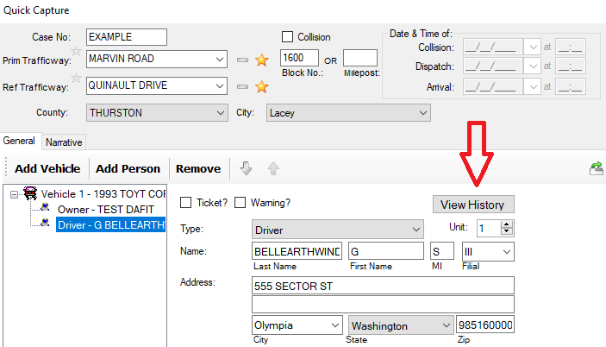
What is SECTOR HISTORY? When a driver’s license is scanned, SECTOR will automatically search the entire SECTOR database for past contacts
The feature only works in quick capture
If there is a history the driver font color will turn red and the “View History” box will appear.
NOTE: If the “Driver” in the left ribbon is still highlighted clicking the View History button will return an error.

Slide 4
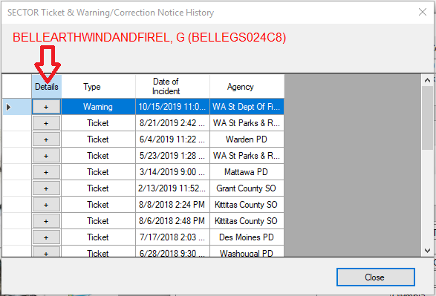
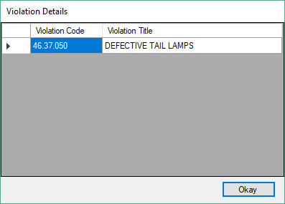
Clicking the plus button will return the contact details

Slide 5
Issues or errors?
The driver’s license has to be scanned to activate search
If you get an error; email sector@wsp.wa.gov and include the OLN of the driver you scanned.
Use SECTOR Warning for all proactive contacts: The more records you create in SECTOR today the more information everyone will have tomorrow.

Slide 6
SECTOR WARNING
Training Guide

Slide 7
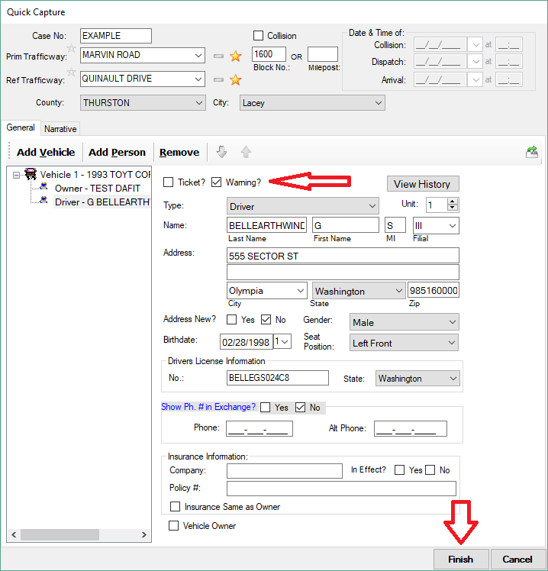
What is SECTOR WARNING
Replaces paper warning
Electronic documentation of violations
Completed just like the existing SECTOR ticket
Select “Warning” instead of “ticket”

Slide 8
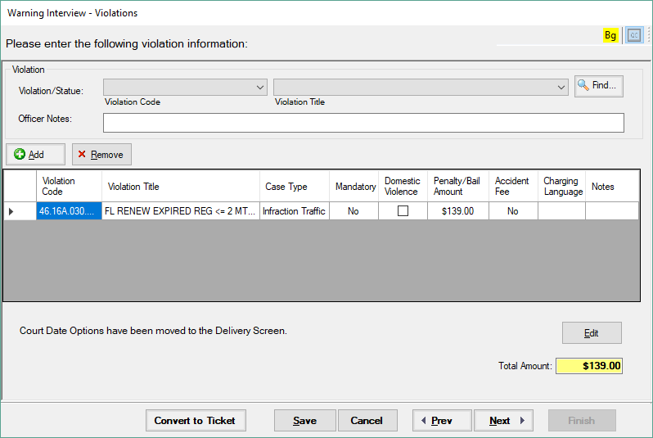
The violations page will display a fine amount but this will not appear on the violator copy

Slide 9
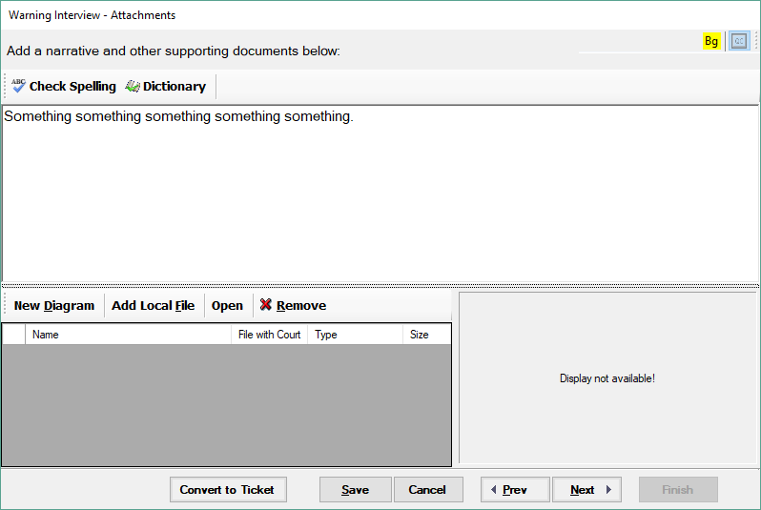
The narrative page is the same as a ticket and will allow you to edit if converted to a ticket at a later time

Slide 10
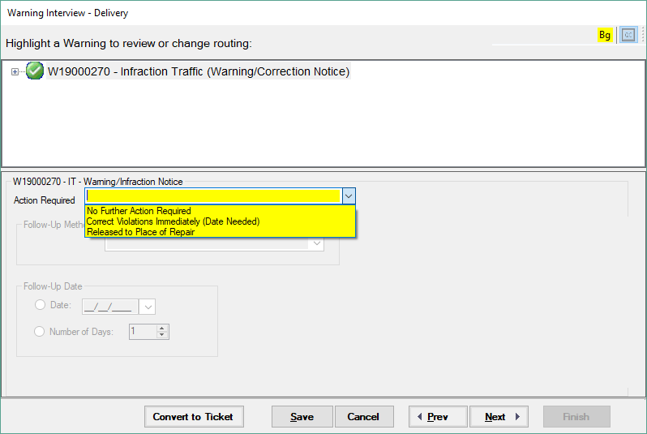
Select the follow up action required
*If you select “No Further Action Required” and choose not to print the warning it will have the same affect as a verbal warning however you have now created a record in SECTOR that will give more information to the next officer who stops this driver*

Slide 11
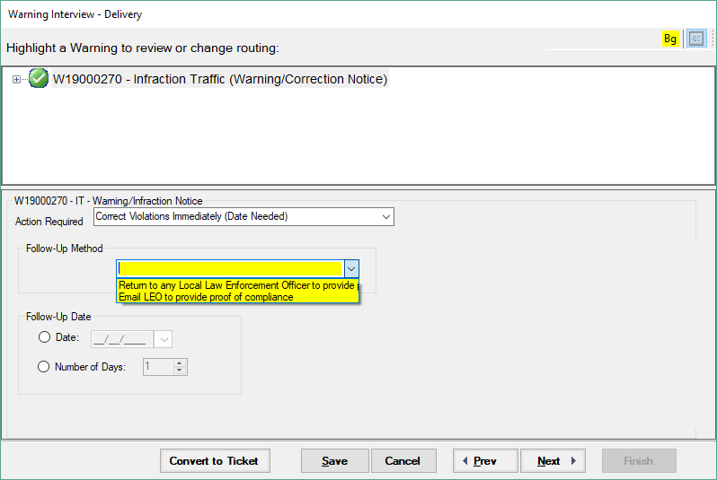
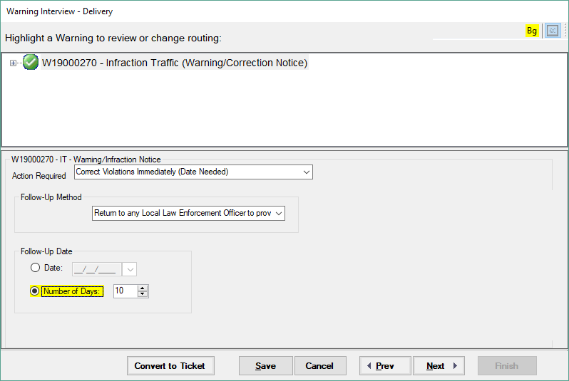
Select the method of validation and the time required
If you select email, your email will appear on the violator copy and allow the subject to send validation of the corrected action directly to you.
If you selected “No Further Action Required” these screens will be skipped
Print and give to the violator or choose not to print for a record only

Slide 12
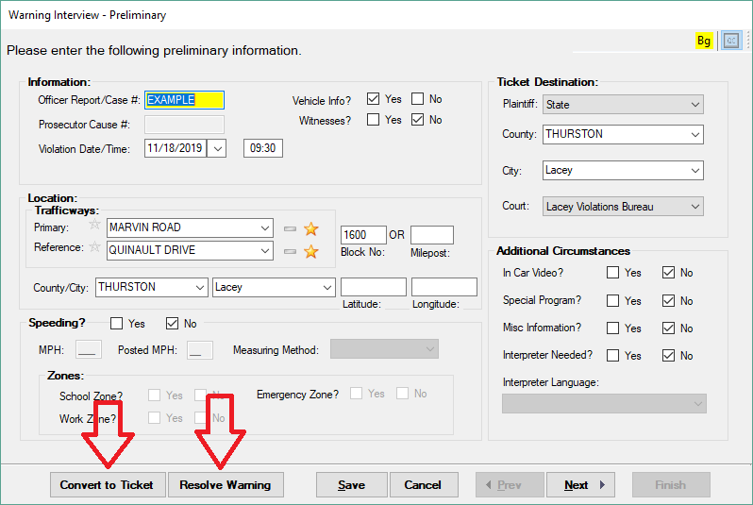
Resolving a warning:
Select the box on the left ribbon
Convert to ticket or Resolve if violation corrected

Slide 13
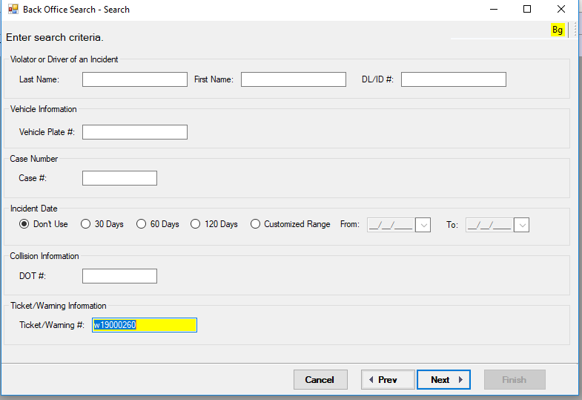
Resolution Options for Non-Issuing Officer
Preferred Option: Scan the Violator Copy which will import the warning directly into your workspace
Secondary Option:
Open SECTOR Back office
Search for the Warning

Slide 14
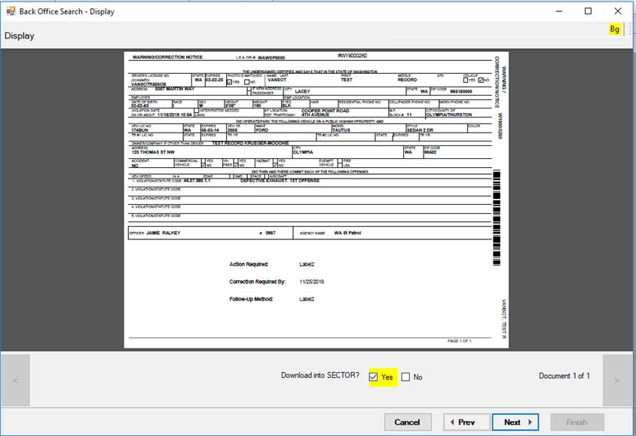
Once the Warning is located select “Yes” to download into your workspace and click “Next”

Slide 15
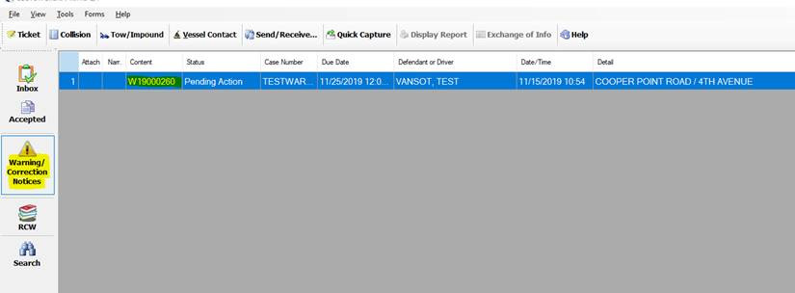
The warning will import into your workspace
Open the warning to resolve

Slide 16
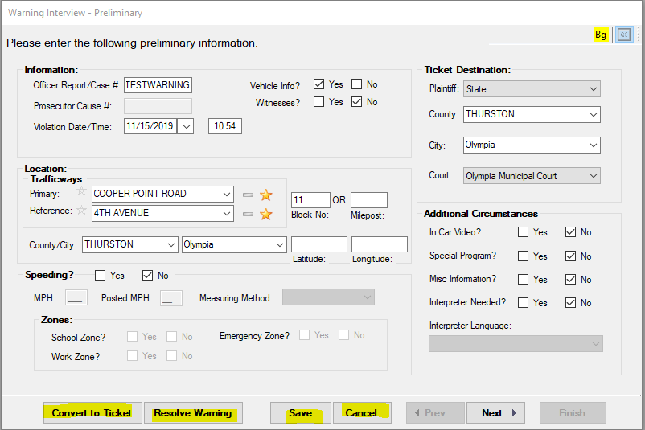
Select “Resolve Warning”, “Save” and then do and send/receive
*Only the issuing officer can convert the warning to a ticket*
The issuing officer will receive a message indicating the warning was resolved

Slide 17
FAQ
Q: Why go to the trouble of issuing a SECTOR warning instead of a verbal warning
A: The more records in SECTOR the more you and your fellow officers will know the next time the driver is contacted.
Q: Will the warning automatically convert to a ticket?
A: No, the issuing officer must convert it to a ticket
Q: The warning was issued for multiple violations but I only want to cite the driver for one violation?
A: Convert the warning to a ticket and remove the violations you don’t want to cite
Q: I did not issue the warning and the violator no longer has their copy, how do I resolve the warning?
A: See slide #8, Search for the warning using their DLN or Name in back office and download it to your workspace.

