Slide 1
RSO Coordinators 101
Sara McCulloch
Deputy Prosecuting Attorney
Senior Specialist- Sex Offender Registration
King County Prosecutor’s Office
Sara.McCulloch@kingcounty.gov
206-205-2697

Slide 2
Legislative History
Community Protection Act- 2/28/90
- RCW 9A.44.130 and .140
Amended 25+ times

Slide 3
Registration Laws
RCW 9A.44.128-.145

Slide 4
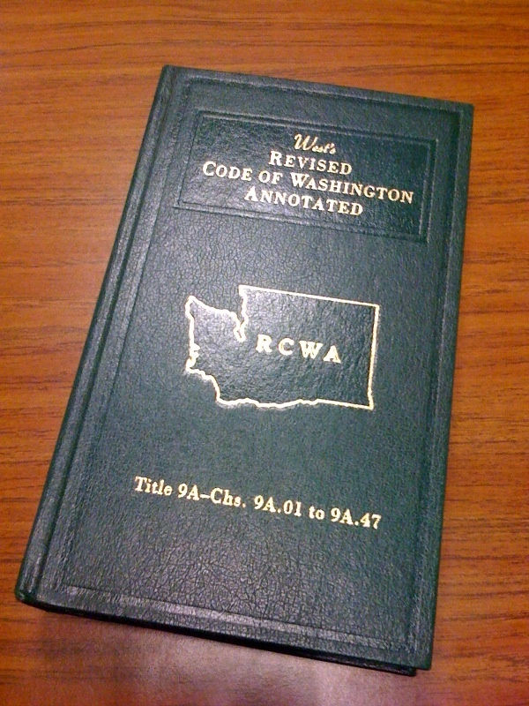
New Structure/ RCWs of the
Registration Laws (2010)
Definition Section 9A.44.128
Registration Requirements 9A.44.130
Penalty Section 9A.44.132
Address Verification 9A.44.135
Duration of Registration 9A.44.140
Notes:
4

Slide 5
New Structure/ RCWs of the
Registration Laws (2010)
Deregistration- Sheriff’s Office 9A.44.141
Petitions for Relief- Adults 9A.44.142
Petitions for Relief- Juvenile 9A.44.143
Notification to offenders- WSP 9A.44.145
Address Verification Grant Program 36.28A.230
Notes:
5

Slide 6
Registerable Offenses

Slide 7
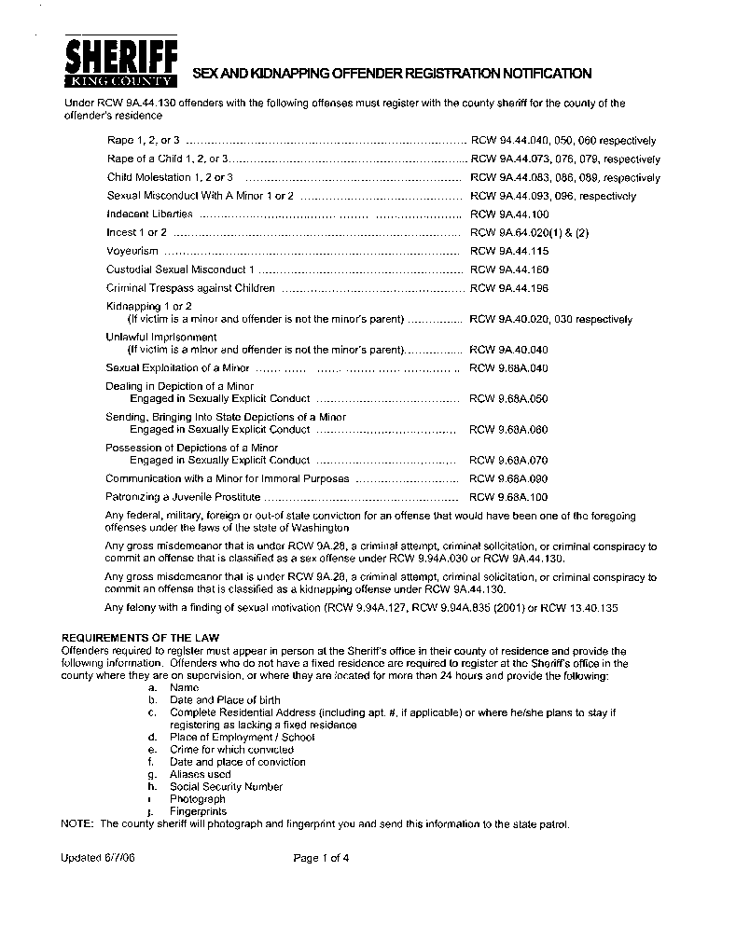
Who Has to Register?
  See KCSO 4 page notification form
  See chart- Registration Consequences by Conviction
  Roughly, any conviction from the 90s, some from the late 80s
  80s and before depends on custody/ supervision
  NOT all sex offenders

Slide 8
What crimes don’t require registration?
Indecent Exposure
Promoting Prostitution 1/ 2 (First Offense)
Patronizing a Prostitute
Promoting Pornography
Permitting Commercial Sexual Abuse of a Minor

Slide 9
Stat Rape/ Ind Libs Crimes
State v. Taylor, 162 Wn.App. 791 (2011).
Stat Rape 1, 2, 3 not a registerable offense due to statutory wording.
Indecent Liberties under 9A.88.100 also not registerable offense
(Indecent Liberties under 9A.44.100 is a registerable offense.)

Slide 10
Sex Offense Convictions
In custody for underlying sex offense on or after 2/28/90
On supervision for underlying sex offense on or after 2/28/90
  Supervision must be ACTIVE supervision, not just MONETARY
Convicted of a sex offense that was committed on or after 2/28/90
Convicted of a sex offense that was committed before, on or after 2/28/90, and the person moved/ returned to Washington State from another state or a foreign country

Slide 11
Kidnapping Convictions
Added in 7/27/97
Same rules as sex offenses, different date
“Kidnapping Offenses” = Kidnap 1, Kidnap 2, Unlawful Imprisonment or any attempt
Victim is a minor and offender is not the minor’s parent

Slide 12
Out-of-State Offenses
“Sex Offense” defined in registration statute as:
  “Any out-of-state conviction for:
    An offense for which the person would be required to register as a sex offender while residing in the state of conviction;
    or if not required to register in the state of conviction, an offense that under the laws of this state would be classified as a sex offense under this subsection.
RCW 9A.44.140(4): “For a person required to register for a federal or out-of-state conviction, the duty to register shall continue indefinitely.”
  May petition the court after 15 years
  Petition is in county of registration (Thurston Co. for juveniles)

Slide 13
Out of State Offense
Does conviction offense qualify as registerable offense in conviction state?
  Call registry/ county sheriff
  Look at registration statute
If so, then offender registers here for life
  Unless offender has COURT ORDER relieving him of duty to register in home state RCW 9A.44.141(a)) or
  Has been relieved of the duty in the home state (RCW 9A.44.141(b))

Slide 14
Example- Out of State Offender
D has an out of state sex offense
How do you figure out if the offender has to register?
  Who does this? No central agency- falls on county sheriff, DOC, etc.
  Obtain copy of charging documents, judgment and sentence
  Call State/ County sex offender registry
    Easy- just came from that state
    Hard- hasn’t lived there ever/ in a long time
  Better: Review out of state registration statute- need documentation to back up decision
  BEWARE telling an offender he does NOT have to register without checking with sheriff for county of residence

Slide 15
Out of State- Examples
Offender required to register in Kansas
Never relieved in Kansas
= Lifetime registration in WA
Offender required to register in Ohio
Relieved of the duty in Ohio due to passage of time (you have been informed by Ohio)
= Should be relieved in WA (9A.44.141(b))

Slide 16
Never Required to Register in Conviction State- Example
Offender convicted of Rape offense as a juvenile in another state
Other state never required offender to register and doesn’t require juveniles to register
=Offender only required to register in WA if we can prove it is comparable offense

Slide 17
Comparability
Issue: Offenders register prior to comparability being established
First, compare elements.
If elements are the same- analysis complete
If elements are not identical, or the foreign statute is broader, then, as a second step, the trial court may examine the facts of the out-of-state crime “ ‘as evidenced by the indictment or information.’

Slide 18
State v. Werneth, 147 Wn. App. 549 (2008)
  GA crime did not have “not married to” and “age” elements that our CM crime has.
State v. Howe, 151 Wn. App. 338 (2009)
  CA crime MUCH broader than WA crime
Very difficult standard to meet where out of state crime is BROADER than WA crime
Requires “findings of fact by the court” as to additional elements of the WA crime.

Slide 19
Notice of Registration in J and S
Notice required by statute
BUT- if no notice, the problem is cured by giving notice.
We don’t need to fix J and S.
Cure the problem by providing actual notice.
(State v. Munds, State v. Clark)
Letter, delivered in person- need proof of receipt
Can have defendant come to court if needed.

Slide 20
Duration of Registation

Slide 21
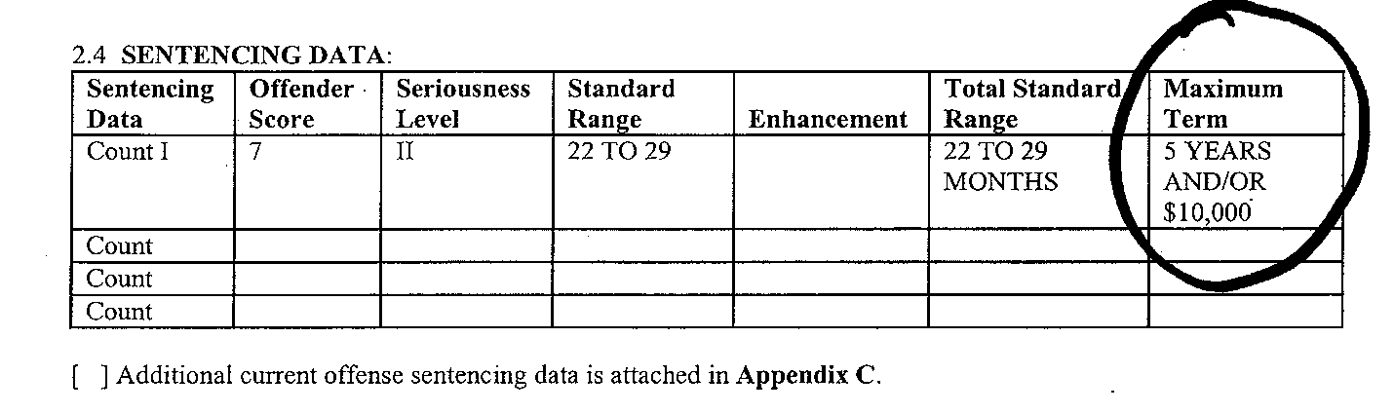
How do I determine class?
Must determine class first
Some crimes have changed class
Judgment and Sentence Maximum Term
  5 years= Class C
  10 years= Class B
  Life= Class A
Notes:
21

Slide 22
Duration of Registration
Federal or Out-of-State Offense= LIFE
Class A (in this state) = LIFE
  or More than one sex or kidnapping offense
  or Offense requiring federal lifetime registration* (“aggravated offense”)
Class B (in this state)= 15 YEARS**
Class C/ Gross Misdemeanor (in this state)
= 10 YEARS**
See Chart on Registration Consequences

Slide 23
**Duration- 10/15 years
** 10 or 15 years must be “consecutive years in the community without being convicted of a disqualifying offense.”
NO LONGER “any new offense”

Slide 24
“Disqualifying Offense”
Felony
Sex offense (using registration definition-9A.44.__)
Crime against children or persons as defined by RCW 43.43.830(5) and 9.94A.411(2)(a)
An offense with a domestic violence designation as provided in RCW 10.99.020
Permitting Commercial Sexual Abuse of a Minor (9.68A.103)
Any violation of 9A.88
(Indecent Exposure, Prostitution crimes)

Slide 25
Disqualifying Offense Cheat Sheet will outline in more detail which crimes restart time.
Out of state “disqualifying offenses”- if it seems comparable, count it.

Slide 26
Federal Lifetime Registration
Intended to require Aggravated Offenders and Recidivists to Register for Life
Will talk more in depth next talk
Looking to see if class B/C offenses are aggravated
The “sexually violent” and “crime against children” definitions are encompassed by rule that more than one sex offense= life
See chart on Registration Consequences of Conviction

Slide 27
FTR Charges:
Should You File Charges?

Slide 28
Filing Standards
Equity considerations
Shorter violation, more likely a reason can be given/ facts don’t look good at trial
King County Standards:
  30 days after move/ 4 weeks of no sign-in
  For occasional homeless sign ins, less than 50% of the time over a 4 month period of time
Community safety concerns-living with children, domestic violence, arrests, etc.

Slide 29
What happens if you don’t file?
Offenders don’t get back in compliance
Public isn’t notified of the offender
Offender winds up having 10/15 years elapsed because no criminal charges
** Make sure offenders are back in compliance after/ during FTR case or if you aren’t able to file for some reason

Slide 30
STOP: Is your offender INCARCERATED?
You don’t want to waste your time filing on someone incarcerated
Review criminal history- recent cases?
DOC: http://www.doc.wa.gov/offenderinfo
King County Jail Booking: http://ingress.kingcounty.gov/inmatelookup/
WASPC List of Jail Registries: www.waspc.org Click on Jails
Federal BOP- http://www.bop.gov
Notes:
I look at their criminal history to see where they may be incarcerated.

Slide 31
Is the offender registered somewhere else?
Is D registered in another county- Offender Watch
Is D registered in another state?
  NCIC- recent arrests, listed registration
  National Sex Offender Registry- http://www.nsopr.gov/
  Doesn’t include all offenders- only 2s and 3s- must call individual State registries or counties

Slide 32
Certified Mail Requirement
Certified mail requirement
  Added in 2010
  Meant to deal with the “Lost in the Mail” defense
  Offenders need notice of the new requirement
  Not meant as an independent reason to charge (e.g. regular mail vs. certified mail)

Slide 33
Filing Charges:
Where Do I Start?

Slide 34
Putting Together an FTR case
Checklist
Sample certification for determination of probable cause
Sample witness statement

Slide 35
What are the elements of FTR?
On or about _________ (date/ range)
Has a sex/kidnapping conviction which requires sex offender registration
  Must prove duration has not expired
Knowingly failed to comply with registration requirements
  Definition section explaining requirements
1 or 2 priors
In the State of Washington

Slide 36
Penalty Section- 9A.44.132
DOC wanted to be able to track types of FTR by looking at citation
5203 amended .132, effective 7/22/11
Prior FTRs are elements of the crime
0 priors .132(1)(a)(i)
1 prior .132(1)(a)(ii)
2 priors .132(2)
Out of State FTRs count- provided we can prove them.

Slide 37
Practice points
Proper citation for FTR should be listed in PC cert/ information
Need to prove up prior FTR convictions (its an element of the crime)
  Need to be listed in PC cert
  Certified J and S for FTR in case file

Slide 38
Where do I start?
Dates, Dates, Dates!
What is your violation date range?
  Begins with date the offender moved/ stopped checking in weekly as homeless
    Please ask witnesses to give dates!
  Ends when you searched the files to see if he has updated his address
  Violation date range can be expanded for trial

Slide 39
What is the violation?
Common types of FTR:
  Homeless, failure to check in weekly, failure to provide accurate accounting of where stayed
  Moved from registered address, unknown where the offender is
  Moved and didn’t register in a timely fashion (check statute for exact requirements)
  Caught living in a new location (usually DV) and still registered at an old address
  Released from prison on underlying sex offense and failed to register

Slide 40
What is the violation?
Another common type of FTR:
Provide a “complete and accurate” residential address 9A.44.130(2)(a)
  Added in 2010 to deal with offenders who conveniently provide incorrect information
  as always, use good judgment on when to file
  if you can’t find them and can’t remedy mistake- file FTR

Slide 41
Unit of Prosecution
State v. Durrett, 150 Wn. App. 402 (2009)
Unit of prosecution is ONE COUNT
  Offense is ongoing duty to report
  Not ended by period of compliance
  Arrest/ charging ends period of noncompliance
State v. Green, 156 Wn. App. 96 (2010)
  Once offender is charged and tried, cannot go back and charge period that occurred before that charging period.

Slide 42
Family/ Friends Cases
When the defendant used to live with family and/or friends- PLAN FOR those witnesses to change their story.
  Details- DATES, where defendant went
  Consider having the witness hand write the statement in their own handwriting if possible or provide a taped statement
  Ask if the defendant stays there even on occasion

Slide 43
Fixed Residence Definition

Slide 44
Fixed Residence/
Lacks a fixed residence
Effective 7/22/11
Need to provide notice to offenders
Consider the factors when you are talking to witnesses on friends and family cases

Slide 45
Fixed Residence
"Fixed residence" means a building that a person lawfully and habitually uses as living quarters a majority of the week. Uses as living quarters means to conduct activities consistent with the common understanding of residing, such as sleeping; eating; keeping personal belongings; receiving mail; and paying utilities, rent, or mortgage. A nonpermanent structure including, but not limited to, a motor home, travel trailer, camper, or boat may qualify as a residence provided it is lawfully and habitually used as living quarters a majority of the week, primarily kept at one location with a physical address, and the location it is kept at is either owned or rented by the person or used by the person with the permission of the owner or renter. A shelter program may qualify as a residence provided it is a shelter program designed to provide temporary living accommodations for the homeless, provides an offender with a personally assigned living space, and the offender is permitted to store belongings in the living space.

Slide 46
"Fixed residence" means a building that a person lawfully and habitually uses as living quarters a majority of the week.
Uses as living quarters means to conduct activities consistent with the common understanding of residing, such as sleeping; eating; keeping personal belongings; receiving mail; and paying utilities, rent, or mortgage.

Slide 47
Lawfully and habitually uses as living quarters a majority of the week.
  Is he allowed to stay here?
  Is he regularly staying here a set number of days a week? How often?
Uses as living quarters means to conduct activities consistent with the common understanding of residing, such as:
  sleeping; - how often?
  eating; - how often?
  keeping personal belongings; - what?
  receiving mail; - what does he receive?
  and paying utilities, rent, or mortgage. - what does he pay?
    doesn’t have to be all of these
    these are examples of the “common understanding of residing”

Slide 48
A nonpermanent structure including, but not limited to, a motor home, travel trailer, camper, or boat may qualify as a residence provided it is lawfully and habitually used as living quarters a majority of the week, primarily kept at one location with a physical address, and the location it is kept at is either owned or rented by the person or used by the person with the permission of the owner or renter.

Slide 49
This group of people will always be difficult to fit into a rule
Meant to allow offenders living in a boat, motor home, camper in a fixed spot to register to that location
  Provides more information via community notification
Excludes squatters, transient people who aren’t staying for very long
Prevents the “I didn’t know he was staying on my property defense”

Slide 50
A shelter program may qualify as a residence provided it is a shelter program designed to provide temporary living accommodations for the homeless, provides an offender with a personally assigned living space, and the offender is permitted to store belongings in the living space.

Slide 51
Meant to allow offenders to register to transitional housing, treatment programs, etc. where the stay is much longer than night-to-night.

Slide 52
Lacks a Fixed Residence
"Lacks a fixed residence" means the person does not have a living situation that meets the definition of a fixed residence and includes, but is not limited to, a shelter program designed to provide temporary living accommodations for the homeless, an outdoor sleeping location, or locations where the person does not have permission to stay.

Slide 53
Homeless:
  Staying at a night-to-night shelter with no guarantee of a spot
  Squatting in abandoned buildings
  Camping, sleeping on the streets
  Other situations that don’t fall under definition of fixed residence

Slide 54
Address Verfication

Slide 55
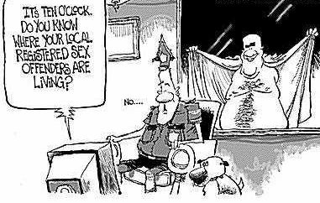
Address Verification

Slide 56
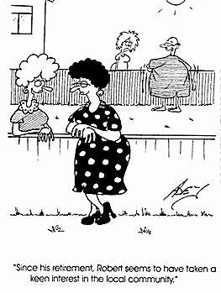
Address Verification
Can an offender be required to cooperate with address verification? YES.

Slide 57
Added to requirements in RCW 9A.44.130:
  (2)(b): “A person may be required to update any of the information required in this subsection in conjunction with any address verification conducted by the county sheriff or as a part of any notice required by this section.”
Failure to comply= FTR
Add to your forms!

Slide 58
Penalties

Slide 59
FTR as a Sex Offender Penalties
 | Gross Misdemeanor | 1st Felony Conviction | 2nd Felony Conviction | 3rd + Felony Conviction
Class of Offense | If underlying sex offense not felony, always GM | Class C | Class C | Class B
Jail/ prison time | 0-364 days | Unranked Felony 0-12 months | Ranked Offense- Level 2- depends on felony criminal history Low 12-14 months High 43-57 months | Ranked Offense- Level 2- depends on felony criminal history Low 14-18 months High 43-57 months
Supervision | Supervision only if court orders probation- no longer mandatory probation | Up to 12 months community custody Supervised by DOC only if high risk on DOC scoring tool | 36 months community custody DOC must supervise | 36 months community custody DOC must supervise
Sex Offense requiring independent registration requirement | No | No- but as a felony offense, it is a Disqualifying Offense that restarts registration time. | Yes- 10 years | Yes- 15 years

Slide 60
Administrative Relief for Offenders

Slide 61
End of Duty- RCW 9A.44.141
Codifies the practice of Sheriff’s offices administratively removing sex offenders from registry
Offenders do NOT need court order for 10/15 year
Defendant can make request (or sheriff can initiate)

Slide 62
End of Duty- RCW 9A.44.141
Sheriff’s Office- reviews records:
  What is the required amount of time?
  Is this an aggravated offense (committed on or after July 22, 2001) requiring lifetime registration?
  Time in community has been met
  No disqualifying offense
  Notifies WSP to remove
No civil liability for removal/ failure to remove offenders

Slide 63
Calculating End of Duty

Slide 64
Registration Consequences
NEW chart!!
Class As/ Agg. Offenses- must petition court
Check on other offenses for Aggravated Offenses

Slide 65
Duration of Registration-
RCW 9A.44.140 (2) and (3)
“The duty to register shall end ten/ fifteen after the last date of release from confinement, if any, (including full-time residential treatment) pursuant to the conviction, or entry of the judgment and sentence, if the person has spent ten/fifteen consecutive years in the community without being convicted of a disqualifying offense during that time period.”
Prior to 2010, any criminal offense reset time period.

Slide 66
2010- “Disqualifying Offense”
Felony
Sex offense (using registration definition-9A.44.128)
Crime against children or persons as defined by RCW 43.43.830(5) and 9.94A.411(2)(a)
An offense with a domestic violence designation as provided in RCW 10.99.020
Permitting Commercial Sexual Abuse of a Minor (9.68A.103)
Any violation of 9A.88
(Indecent Exposure, Prostitution crimes)
Notes:
66

Slide 67
2011- “In the Community”
Lots of questions about what “in the community” meant
In this county? This state? This country?
What if you went to jail for DUI?
9A.44.128: “In the community” means residing outside of confinement or incarceration for a disqualifying offense.

Slide 68
Disqualifying Offense Examples
4 types of FAQ:
  Confinement on a non-disqualifying offense
  Conviction for Att. FTR
  Conviction for FTR Gross Misdemeanor
  Warrants and non-compliance with registration

Slide 69
Confinement for
Non-Disqualifying Offense
D convicted of CMIP in 2000. 10 year registration period.
He was released at sentencing- Jan. 2000
He has since been convicted of DUI in 2005 and spent one year incarcerated.
Does his period of registration end in January 2010.
Yes.

Slide 70
Conviction for Att. FTR
(Gross Misdemeanor)
D convicted of Rape 3 in 2000. 10 year registration period.
He was released Jan. 2001.
He has since been convicted of Att. FTR in 2009 (gross misd.)
Does his period of registration end in January 2011.
Yes.

Slide 71
Conviction for Gross Misdemeanor FTR
D convicted of CMIP in 2000. 10 year registration period.
He was released June 2000.
He has been convicted of Gross Misd. FTR every year since his release.
Does his period of registration end in June 2010?
Yes.

Slide 72
Warrants and Non-compliance with Registration
D convicted of Class B sex offense- 15 year registration period.
He was released from prison June 1995.
State filed charges for FTR in 1998.
Warrant has been outstanding since 1998.
No other criminal convictions; has been out of compliance with registration since 1998.
Does his period of registration end in June 2010?
Yes.

Slide 73
Questions?
Sara McCulloch
Deputy Prosecuting Attorney
Senior Specialist- Sex Offender Registration
King County Prosecutor’s Office
Sara.McCulloch@kingcounty.gov
206-205-2697

