Slide 1


Slide 2
Genesis of CILEP
2020: Nationwide protests and significant loss of public trust
COVID-19 pandemic subsequent challenges
Loss of officers and police applicants both regionally and nationwide
Opportunity to take a meaningful step toward the community, specifically communities of color, in attempt to earn and sustain public trust
Chief’s vision: Deploy newly hired police recruits to serve the community for an extended period of time prior to the academy
Goal: To promote human dignity and increase our officers’ cultural competency through an immersive experience of service in cultures other than their own

Slide 3
CILEP Problem Statement
Law enforcement agencies historically struggle to culturally represent the communities they serve and support
It is reasonable to believe that the ethnic and cultural gap between LE and the community continues to undermine police/community relationships and erode public trust
Most law enforcement officers do not live in the communities they serve and support
The City of Kent is rich with cultural diversity. There are more than 140 recognized languages represented in the Kent School District
In the past two years we’ve increased underrepresented candidates hired to 47%

Slide 4


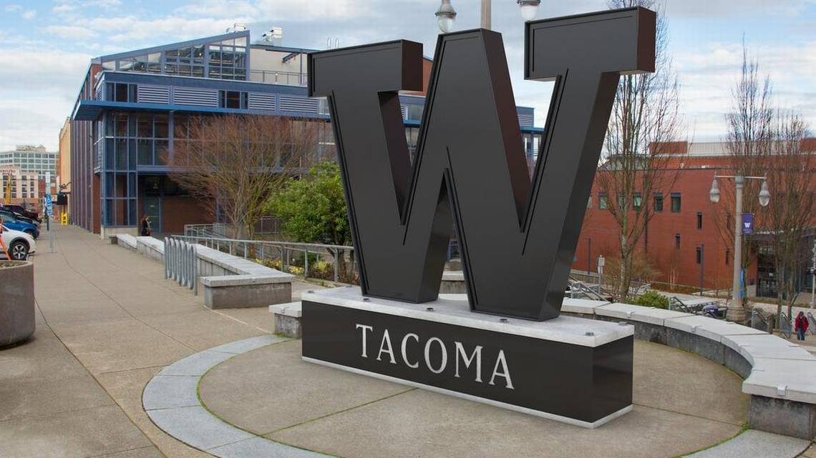


STAKEHOLDERS
Kent Police Department
Rep. Tina Orwall’s Office
University of Washington - Tacoma
World Relief Seattle
Vine Maple Place

Slide 5

Program Design
All newly hired police officers will participate in the project
Recruits will be placed with a community-based organization (CBO) and assigned a mentor
Recruits will report to CBO for 8 weeks (320 hours)
Weekly reports to reflect learning
Kent PD reintegration and debrief-40 hours
Basic Law Enforcement Academy (BLEA)

Slide 6
World Relief:
Mission Statement
World Relief Western Washington's is a faith-based organizations whose goal is to serve the world's most vulnerable populations. They aim to tackle the world’s greatest problems with holistic, locally-driven solutions that lead to lasting change — whether in response to disasters, extreme poverty, violence, oppression or mass displacement and immigration.
World Relief’s work in the United States, specifically, focuses on helping refugees and other immigrants in vulnerable situations rebuild their lives in a new country.

Slide 7

World Relief: Activities
Fall of Kabal in August of 2021
Russian invasion of Ukraine February of 2022
Helped newly arrived Afghani families fill out documents and enroll their children in school
Helped locate host families and/or apartments in the area for program participants and moved them in
Helped complete immigration documents
Drove participants and their children to medical/dental appointments
Collected and delivered home goods to newly arrived participants
Taught ESL classes to community members
Drove a community member from Cameroon to first job interview and helped him prep for questions (the job was offered!)
Supported group of Hattian men released from the ICE detention center and provided transportation

Slide 8
Vine Maple Place: Mission Statement
Vine Maple Place is a faith-based organization that breaks the generational cycle of homelessness by working with single parents and their children. Their approach offers safety, provides stability, and equips to self-sufficiency.
The vision of Vine Maple Place is to end family homelessness in South King County, resulting in healthier communities where every child and parent has a stable home to grow and thrive.

Slide 9
Vine Maple Place: Activities
  Mentoring and tutoring youth and teens experiencing homelessness or in shelter
  Teaching Financial literacy, resume writing, and job interview skills
  Review, interview, and screen client applications for the various programs

Slide 10
Vine Maple Place Recruit Feedback
  "This was my first time interacting personally with people actively experiencing homelessness and developing a deeper understanding of the challenges they face." -Recruit
  "Throughout my time at VMP, I had the opportunity to interact with people experiencing difficulty in their life, from single moms living in their cars with their kids, to kids facing the uncertainty of not knowing where they will go to sleep that night or where their next meal will come from. This experience has taught me to approach people with compassion because I don’t know what they are dealing with." -Recruit
  "I’m working through the Motivational Interviewing (MI) curriculum, a non-confrontational, collaborative way of talking to people as a means of helping them intrinsically decide to make positive change in their life. I can see how this could potentially be useful when interacting with the public as a police officer." -Recruit

Slide 11

Program & Learning Goals
Provide officers firsthand experience and in-person engagement designed to impart understanding, empathy, compassion and trust
Forge life-long personal relationships between officers, service providers, and community members
Strengthen communication and trust between the Kent Police Department and our community members
The ability to self-reflect on and acknowledge any implicit biases
Demonstrate the ability to communicate effectively with Kent residents from cultures other than their own
Recruits demonstrate the ability and eagerness to learn about cultures other than their own including subcultures within groups

Slide 12
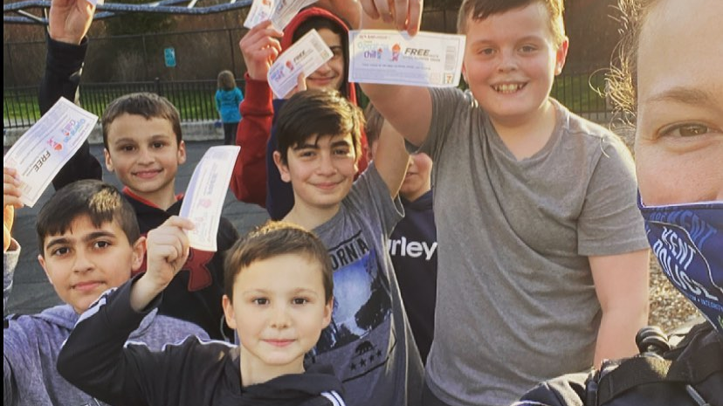
WHAT COMMUNITY IMMERSION ACCOMPLISHES
New officers recognize serving the community is foundational to their role as Kent Police Officers
Community mentors and organizations are shaping our officers from the ground up and empowering them with their diverse perspectives
New officers learn from interactions with cultures other than their own before they make critical decisions on the street
New officers know how to connect community members to local organizations and resources in their time of need
KPD is developing and evaluating our recruits’ cultural competency before they become officers and are attracting recruits who value the ethic of service and community engagement

Slide 13
Evaluation
>Process evaluation of first year pilot program
–19 recruits completed program
–1 CBO organization
>Data collection methods:
–Qualitative interviews
>28 one-on-one interviews (12 stakeholders, 16 recruits)
–Quantitative Survey
>Recruit survey (16 recruits)

Slide 14
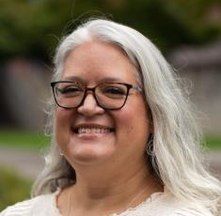
University of Washington Tacoma
Meaningful interactions with community based organization clients which deepened their understanding of refugee and asylee experiences and foster learning about the systems that community members navigate
Recruits self-reported knowledge about community resources and cultural practices increased over the placement period
CILEP stakeholders reported the process of developing and implementing the program during its first year both built and deepened partnerships in the Kent community
The pilot implementation year of CILEP suggests this is a promising program with the potential to have positive impacts on new police recruits and the communities they serve

Slide 15
Impacts on Recruits
Community Interactions & Engagement
“I showed this family...what I take for granted literally every day. I showed them what we do on a regular basis...Now they're teaching their kids the exact same thing that I taught them, and I think it's small but to them it's huge, so it's cool." -Recruit
“I was interacting with folks that I probably wouldn't have in any other type of scenario, just probably because our lives wouldn't have ever entwined." -Recruit

Slide 16
Personal Connections with Clients
“I had a whole family who, um, invited me to their home to have a meal, and it turned out to be a very nice meal. There was food everywhere on the plates – on the table, and they were like, 'why can't you eat?' And I'm like, 'cause this is way too much food. This is ridiculous. [warm laughter] 'And then, the children didn't want me to leave, and it was – it was very nice. It was very – and they still – She still texts me to this day to ask how I'm doing." -Recruit

Slide 17
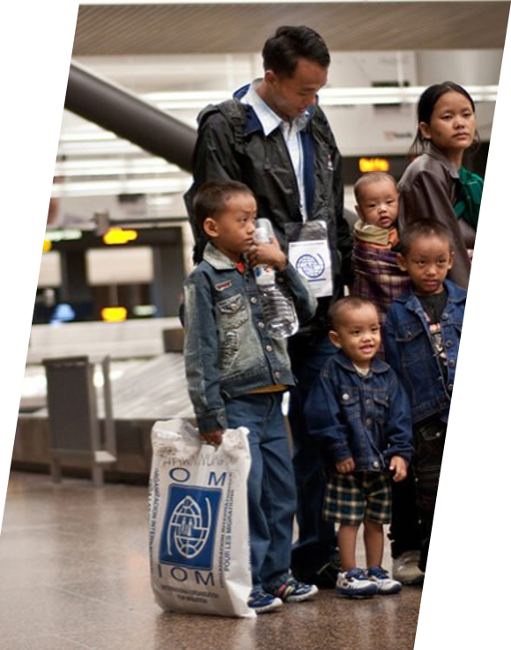
Challenges
Finding partner organizations with full time work and high-quality supervision
Line level and union buy-in
Funding and financial contracts
Anticipating academy wait times
Coordinating research efforts

Slide 18
Current Status of CILEP
40 Kent PD recruits have completed the program
DOC grant fully funding our current year
Expanded to 3 community-based organizations
Improved orientation and understanding of learning goals
Ongoing formal study by University of Washington

Slide 19

Questions?
Assistant Chief Andy Grove​
Kent Police Department​
Agrove@kentwa.gov

