Slide 1
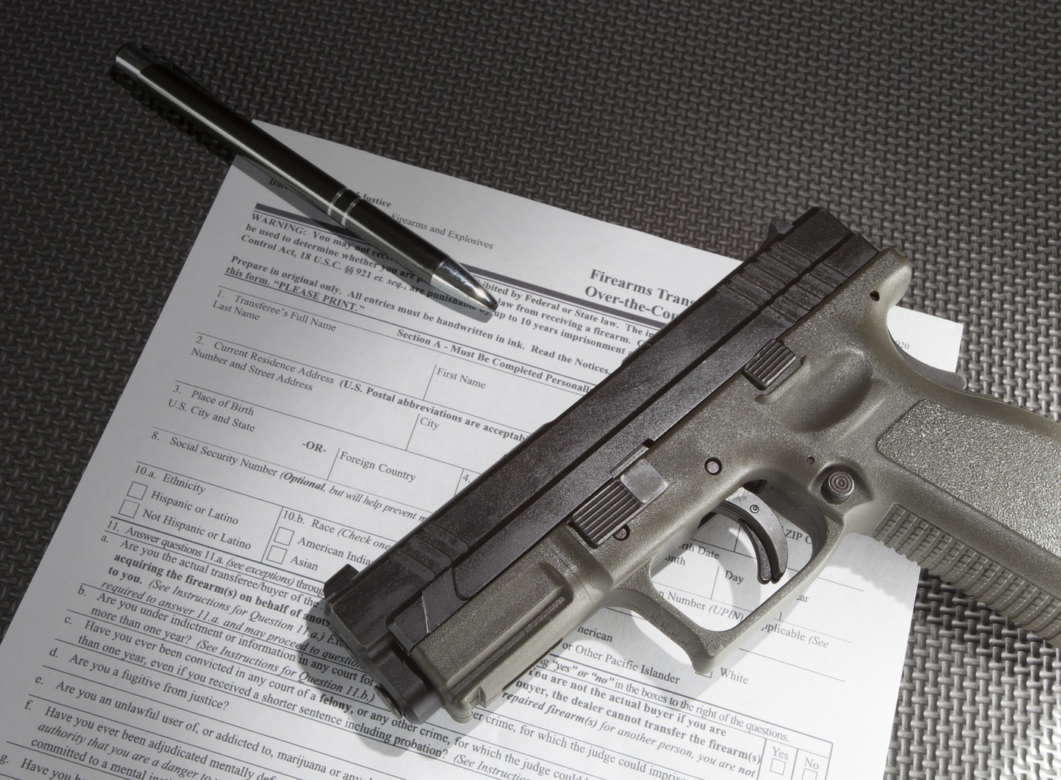
Washington State Patrol Firearms Background Check Program
November 17, 2021
Presented by: Kateri Candee – Division Commander

Slide 2
Centralized Firearms Status
2020 Legislative session passed ESHB 2467
May 2020 – December 2020
Implantation Plan completed
January 2021
Hired a Project manager, Technical Architect and Quality Assurance personnel
March 2021 – October 2021
RFP for technology; Selecting a vendor; Contract negotiations; Contract signed
November 2021 – July 2023
Catalyst Consulting building the system to conduct the background checks
Secure Automated Firearms E-check - SAFE
WSP in parallel will be working on building the Division
Finding space / Establishing positions / Hiring staff / Acquiring equipment
July 2023
Soft launch with some FFL’s
January 2024
Full Roll-out of the system
Notes:
2020 Legislative session passed ESHB 2467 saying WA State will become a full point of contact state and firearm transfers will be handled by the WSP. The bill also stated that the WSP would build an Implantation Plan of how that would work in WA State. The Implementation Plan was built to guide on the technology and building a new division within WSP to house over 60 staff. The bill included, long-guns, SAR’s, handguns. “other” (parts of a firearm) and pawned guns.
Currently long-guns and “other” are being sent to the FBI NICS section directly for the check from the FFL
Hand-guns and SAR’s are being sent to the local jurisdiction from the FFL for the background check
May 2020 – December 2020 - Implantation Plan completed
January 2021 - Hired a Project manager, Technical Architect and Quality Assurance personnel
March 2021 – October 2021 - RFP for technology; Selecting a vendor; Contract negotiations; Contract signed
November 2021 – July 2023 - Catalyst Consulting building the system to conduct the background checks
Secure Automated Firearms E-check - SAFE
WSP in parallel will be working on building the Division
Finding space / Establishing positions / Hiring staff / Acquiring equipment
July 2023 - Soft launch with some FFL’s
January 2024 - Full Roll-out of the system

Slide 3
Concealed Pistol License (CPL) & Disposition of Firearm (DOF)
ESHB 2467 did not in address CPL’s or DOF???
Background check is the same as a firearm transfer
Listserv – built for FFL and LEA
Discussion stage
Unknowns / concerns
Processing – who will do what?
Fees – how will they apply?
Liability – LEA name on the card?
3rd party vendors?
Things to think about
LEA name on card – is that really needed?
Generic seal produced by DOL?
DOL’s Firearms online system and SAFE – double entry?
Notes:
ESHB 2467 did not in address CPL’s or DOF???
The background check is the same as a firearm transfer
NICS
Mental Health
Local records
Last month a Listserv was built for FFL and LEA – this was built for announcements of what is happening with the centralized program.
The instruction sheet to sign up – had misinformation on it. It said that WSP will conduct the background check for CPL’s and DOF and as stated earlier those two items were not part of ESHB 2467
This got a few agencies concerned
We sent out another message advising we made a mistake and it should have read we are looking at what would it look like to add the language to include CPLs and DOF as they require the same check as a transfer
We are truly in the discussion stages right now
There is an Advisory Board that was established to oversee the firearms implementation and we meet monthly.
This topic has been an item of discussion
On that board is Sheriff Hawley – Okanogan Co So / Chief Siebert – Quincy PD / AC Marc Lamoreaux – WSP, An FFL – Sportco and a general public member
Unknowns / concerns
Processing – who will do what?
Local law enforcement role for CPL:
Initial CPL - Take the fingerprints of the subject and send those to WSP/FBI to process
When WSP receives the prints the system would send a notification to SAFE to process the other piece of the background check
SAFE will process background check reviewing all of the required databases:
National Instant Criminal Background Check System (NICS) – which includes:
NICS Indices
III (national criminal history)
NCIC (national hot files)
WACIC (state hot files)
WASIS (state criminal history)
LInX-NW and N-DEx - local data
Administrative Office of the Courts (AOC) – direct link to cases that are not in WASIS or III
Health Care Authority (HCA) – direct link into the database without having to fill out a form and fax it to them, as is done now
After the background check is complete the law enforcement agency will receive the results of the fingerprints and the results of the firearm background check from SAFE.
The agency can then issue the CPL if they chose or not based on the information they receive.
Renewal CPL – Since prints are not required for a renewal the agency will send the check (name and date of birth) through the new WSP portal. This is the same place you will be receiving your results and secure messages from WSP
Fees – how will they apply? Currently
Fees: $36 plus FBI imposed charge - $13.25 – the State Patrol does not charge for the state fingerprint processing – Total to get a CPL is $49.25
$36 broken down
$15 to general fund
$4 to the agency taking the prints – this fee would remain with the agency taking the prints
$14 to the issuing authority – this fee would remain with the issuing authority as we heard concerns from local law enforcement agencies they would like to know who has a CPL in their jurisdiction
$2.16 to the Firearms Range account
$.84 to DOL CPL renew
State Patrol role for CPL:
WSP is requesting to have the $18 fee that was identified in ESHB2467 to be added to the CPL fee which would cover the cost of operations of the Centralized Firearm Program. The fee would be added to the applicant not the local law enforcement agencies. This would bring the total to get a CPL to $67.25.
Liability – LEA name on the card?
We heard agencies have concerns about having their name on the card and WSP is conducting the background check. We understand this concern. The systems being used by LEA’s are the same ones that WSP will be using – there is pride in what the records clerks do and we understand that.
The CPL does not give the subject the right to own or purchase a gun. The CPL is truly that a license to carry concealed.
If the subject wanted to purchase a firearm they will still have to go through another background check. This check would be conducted by the WSP for the firearm.
3rd party vendors – permitium – we believe many of your agencies use this vendor to assist in processing CPL’s – we believe their role would remain – unless I am missing something
Mercer Island / Thurston Co So / Whatcom Co So / Stevens Co So / Grant Co So / SS911 / Pacific Co So / Snohomish Co So – just to name a few
Things to think about
LEA name on card – is that really needed?
Generic seal produced by DOL?
Every other license in WA has a generic seal – why is this one different? The RCW does not state it has to be one way or the other
DOL has a system that is used by law enforcement agencies to submit the CPL application – Firearms online – how would this work with SAFE and trying to ensue agencies didn’t have double entry?

Slide 4
Questions/Discussion
Email the Firearms Division at – Firearms@wsp.wa.gov

