Slide 1
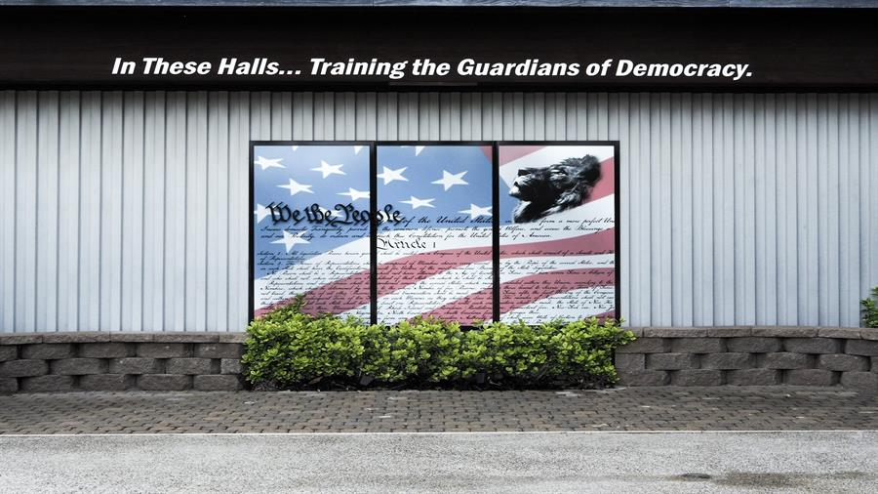
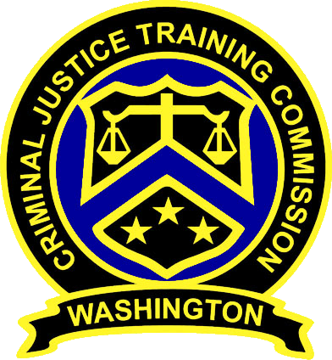
MASTER INSTRUCTOR PROGRAM
2021

Slide 2
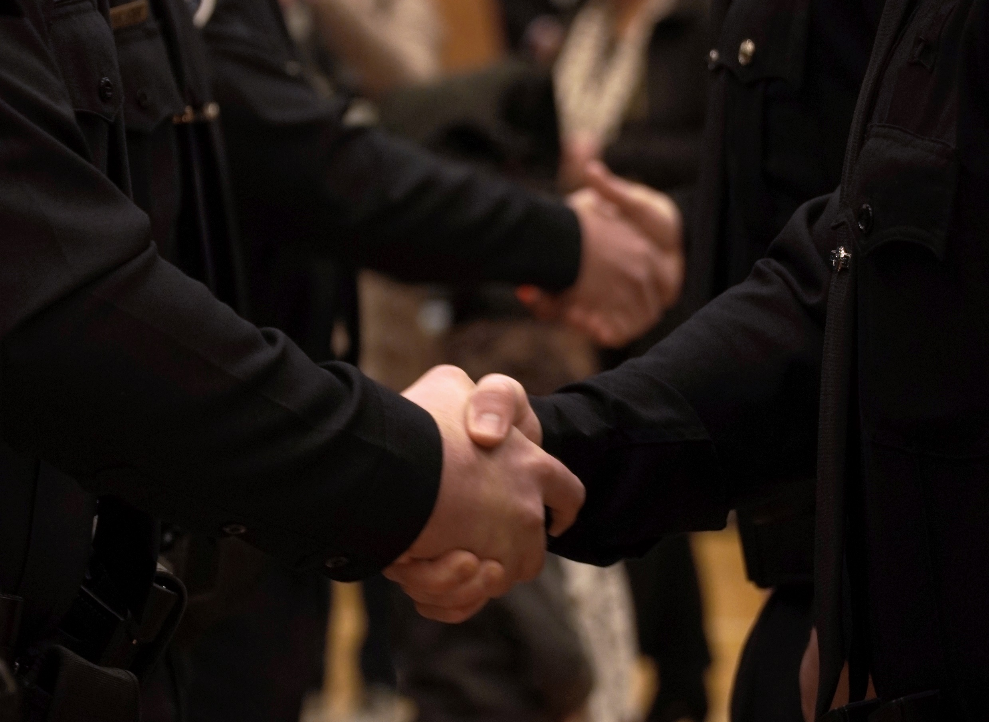
As a Chief Law Enforcement Executive, you should expect that your commitment to the Master Instructor program will enrich your connection between the Washington State Criminal Justice Training Commission, Basic Law Enforcement Academy, and regional partners as it pertains to the integration of control and defensive tactics and field application.
The Master Instructor program should serve our stakeholders as a regional resource.
Each Master Instructor is a Subject Matter expert in:
Violence De-Escalation
Use of Force applications
Control & Defensive Tactics training

Slide 3
CURRENT REQUIREMENTS for Master Instructor Certification
Becoming a Master Instructor requires 400 hours of initial training and can take 3-5 years to attain certification
*there is no requirement or obligation to share the 400 hours of training with your agency, neighboring agencies or region
Completion of 40 Hours for Recertification Training each subsequent year
All trainings occur in Burien
Master Instructor Program Deficiencies
Limited initial benefit to home agency
Very little to no regional support to neighboring agencies
Limited collaboration between statewide MI’s & the CJTC

Slide 4
Current Master Instructor Course Breakdown
80 HOURS
80 HOURS
40 HOURS
24 HOURS
Advanced Concepts of Motor Learning & Performance (ACMLP)
40 HOURS (ANNUALLY)
Level I (Control Tactics)
Baton (Impact Weapons)
Vascular Neck Restraint (VNR)
Master Instructor Recertification Training
Level II (Defensive Tactics)
Ground Survival
Oleoresin Capsicum Spray Instructor Training
Master Instructor Training
40 HOURS
40 HOURS
16 HOURS
40 HOURS
TOTAL 400 HOURS
(Including Annual Recertification)
*All required training was held on the campus of the WSCJTC in Burien
*No needed pre-requisite training before attending Level I or II classes

Slide 5
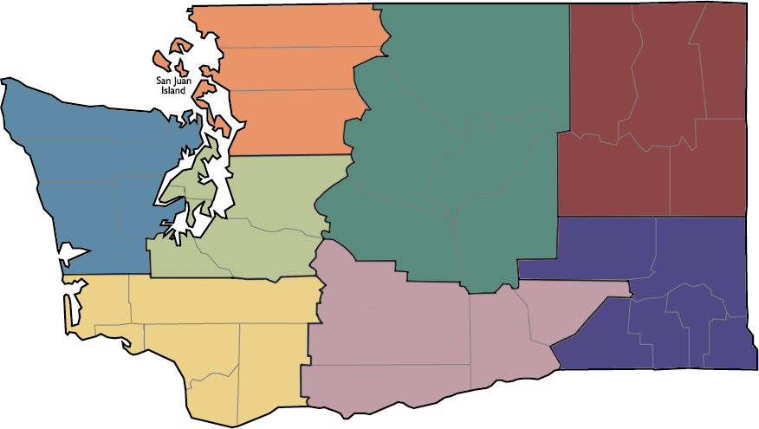
Which regions support the MI Program?
How many certified MI’s are there in the state?
How do the MI’s support their agency and regional neighbors?
Whatcom
Pend Oreille
14
Ferry
Skagit
Okanogan
8
Stevens
NORTH
NORTH CENTRAL
Clallam
NORTH EAST
Snohomish
Jefferson
WEST
Chelan
13
King
Douglas
Kitsap
Lincoln
Spokane
Grays Harbor
7
Mason
SOUTH
Kittitas
1
69
Grant
Whitman
Region | No. of M.I.’s in Region
NORTH | 14
NORTH CENTRAL | 7
NORTH EAST | 8
SOUTH | 69
SOUTH CENTRAL | 12
SOUTH EAST | 1
SOUTH WEST | 6
WEST | 13
TOTAL | 130
Thurston
Pierce
Adams
SOUTH EAST
Pacific
Lewis
Yakima
Franklin
Garfield
SOUTH WEST
Wahkiakum
12
SOUTH CENTRAL
Columbia
Benton
Walla Walla
Asotin
Cowlitz
Skamania
6
Klickitat
Clark

Slide 6
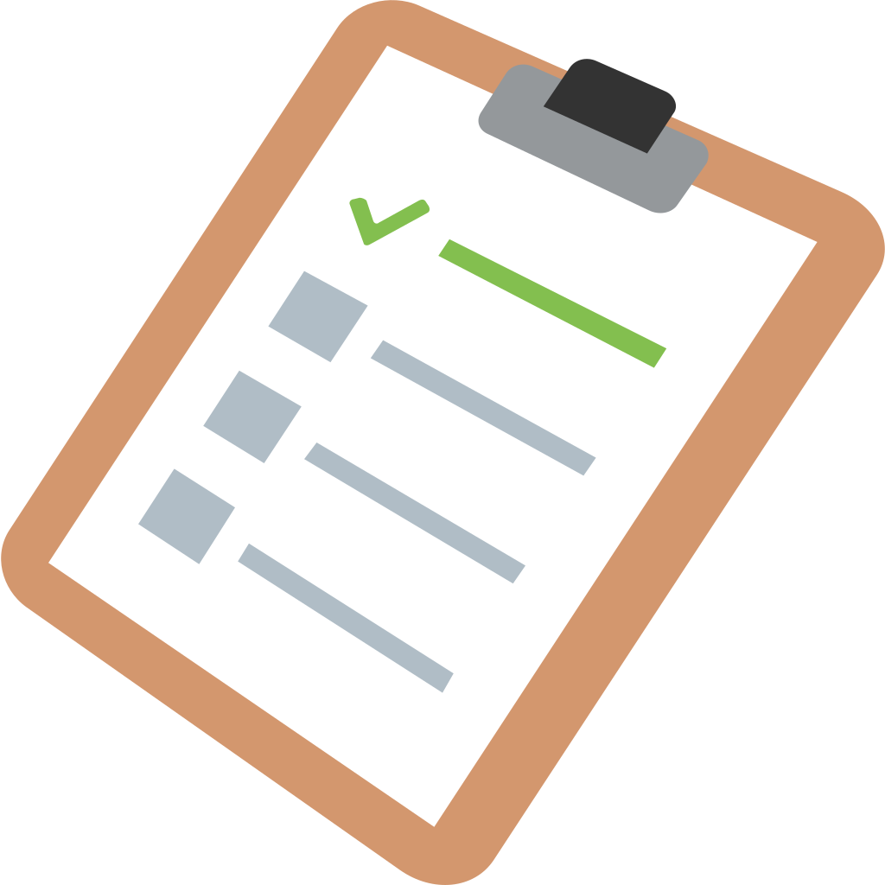
NEW REQUIREMENTS of Master Instructor Program
Submit the endorsement letter from the Chief LE Executive of the agency
Complete steps to become a Certified Master Instructor (hosted by regional partners and sites)
Students currently in the pipeline to become a Master Instructor will not be impacted by this change, but the new expectations to support regional training will apply

Slide 7
80 Hours Instructor Course
A small group of Master Instructors created the new program requirements in consultation with the full cadre of MI’s from around the state.
200 Hours of Guided Instruction to their Region
80 Hours Lead Instructor Course
200 Hours of Guided Instruction to their Region
40 hours of Master Instructor training (hosted in Burien only)
200 Hours of Guided Instruction to their Region
40 hours of Annual Recertification, Statewide Collaboration and Regional Report-Out
Participate in one quarterly 2-hour online workshop.

