Slide 1
Sex Offender Registration and Community Notification Meeting

Slide 2
Who are the Sex Offenders?
Sex offense statistics from the NSOPW:
An estimated 60% of perpetrators of sexual abuse are known to the child but are not family members, e.g. family friends, babysitters, child care providers, neighbors, etc.
About 30% of perpetrators of child sexual abuse are family members.
Only about 10% of perpetrators of child sexual abuse are strangers to the child.
Approximately 30% of sexual assault cases are ever reported to authorities
For more statistics on sexual abuse please visit: https://www.nsopw.gov/en-US/Education/FactsStatistics#sexualabuse

Slide 3
Why do we need to talk about them?
Most will be released into the community.
Most are not under correctional supervision.
Most can be safely managed in the community.
Communities can help sex offenders stabilize, thereby reducing recidivism.
An informed community is a safer community.

Slide 4
Community Safety is Our Concern
Stability of an offender can prevent future victimization.
Harassment of offenders may increase risk to the community:
  Offenders may go “underground” so law enforcement will not be able to monitor them
  Offenders may feel out of control or targeted and re-offend
  Offenders may stop treatment

Slide 5
Community Protection Act of 1990
The Community Protection Act was unanimously passed by the Legislature and signed into law on February 28, 1990.
Groundbreaking Changes:
Sex Offender Registration
Community Notification
Civil Commitment of Sexually Violent Predators

Slide 6
Purpose of the CPA of 1990
Public website allows community members the ability to search for published offenders in their area, or people that they are coming into regular contact with. Giving people the opportunity to take common sense measures to protect themselves and their families.
Public website also provides a means for victims to maintain knowledge of where higher risk offenders are.
Allows law enforcement to know where these offenders are and do address verifications to check in with them. Sometimes this is the only opportunity to check in on these people and interact with them in a positive way. Continuing these interactions may help to deter behavior or allow LE to observe behaviors that increase risk. Additional sense of accountability for the registrants.
Gives law enforcement a starting place or resource when investigating sexually motivated offenses where the suspect is unknown.
Allows school notifications so that administrators and teachers can be aware of behavior to watch for.

Slide 7
Who has to register?
Beginning July 23, 2023, adults and juveniles convicted/adjudicated of sex offenses have different registration requirements.
Registration laws are covered in Chapter 9A.44.
RCW 9A.44.128 defines an adult as a person who is 18 years of age or older on the offense date or who is 17 or younger on the offense date and convicted of and sentenced for an offense in adult court pursuant to RCW 13.04.030(1)(e)(v) or 13.40.110.

Slide 8
Who has to register? (cont.)
Adults are required to register if they have been convicted of a class A, B, C felony or some gross misdemeanor sex offense (defined in 9A.44.128).
Juveniles are required to register under the following conditions:
Age 16 or 17 at the time of offense and adjudicated of a class A or B felony sex offense and did not receive a Special Sex Offender Disposition Alternative (SSODA) under RCW 13.40.162 or had their SSODA revoked;
14 or 15 at the time of the offense and were adjudicated of rape in the first degree;
14 or 15 at the time of the offense and were adjudicated of rape in the second degree and did not receive a Special Sex Offender Disposition Alternative (SSODA) under RCW 13.40.162 or had their SSODA revoked;
Adjudicated of a sex offense and on the date of the offense, had a prior adjudication for a sex offense as defined in RCW 9A.44.128 or had a deferred disposition for a sex offense pursuant to RCW 13.40.127;
Has an out-of-state, tribal or federal conviction for a sex offense;
Has been adjudicated of a kidnapping offense; OR
Is ordered by the court to register under certain circumstance outlined in RCW 9A.44.130(1)(b)(vii).

Slide 9
What is a registerable sex offense?
RCW 9A.44.128
Definitions applicable to RCW 9A.44.130 through 9A.44.145, 10.01.200, 43.43.540, 70.48.470, and 72.09.330.
(10) "Sex offense" means:
Any offense defined as a sex offense by RCW 9.94A.030;
Any violation under RCW 9A.44.096 (sexual misconduct with a minor in the second degree);
Any violation under RCW 9A.40.100(1)(b)(ii) (trafficking);
Any violation under RCW 9.68A.090 (communication with a minor for immoral purposes);
A violation under RCW 9A.88.070 (promoting prostitution in the first degree) or RCW 9A.88.080 (promoting prostitution in the second degree) if the person has a prior conviction for one of these offenses;
Any violation under RCW 9A.40.100(1)(a)(i)(A) (III) or (IV) or (a)(i)(B);
Any gross misdemeanor that is, under chapter 9A.28 RCW, a criminal attempt, criminal solicitation, or criminal conspiracy to commit an offense that is classified as a sex offense under RCW 9.94A.030 or this subsection;
Any out-of-state conviction for an offense for which the person would be required to register as a sex offender while residing in the state of conviction; or, if not required to register in the state of conviction, an offense that under the laws of this state would be classified as a sex offense under this subsection;
Any federal conviction classified as a sex offense under 42 U.S.C. Sec. 16911 (SORNA);
Any military conviction for a sex offense. This includes sex offenses under the uniform code of military justice, as specified by the United States secretary of defense;
Any conviction in a foreign country for a sex offense if it was obtained with sufficient safeguards for fundamental fairness and due process for the accused under guidelines or regulations established pursuant to 42 U.S.C. Sec. 16912;
Any tribal conviction for an offense for which the person would be required to register as a sex offender while residing in the reservation of conviction; or, if not required to register in the reservation of conviction, an offense that under the laws of this state would be classified as a sex offense under this subsection.

Slide 10
How long does registration last?
Adults: Class A = Lifetime; Class B = 15 years; Class C or gross misdemeanor = 10 years. Those with more than 1 conviction or have been deemed to be a sexually violent predator under RCW 71.09 will have to register for lifetime regardless of the class.
Non-Adults: Age 15, 16 or 17 at the time of the offense registering as a result of a class A felony sex offense will register for 3 years; all others will register for 2 years.

Slide 11
What are the registration requirements?
Offenders required to register must appear in person at the sheriff’s office in their county of residence, or if not a Washington resident, the county of the person’s school, employment or vocation or as otherwise required in 9A.44.130.
The offender must provide:
  name and any aliases used
  the complete and accurate residential address or if lacking a fixed residence where he or she plans to stay
  date and place of birth
  place of employment
  crime for which convicted, date and place of conviction
  social security number
  photograph and fingerprints

Slide 12

What if an offender doesn’t register?
Failure to register as sex offender or kidnapping offender
RCW 9A.44.132

Slide 13
What is a risk level?
Risk levels refer to an individual offender’s risk to sexually reoffend within the community at large.
Risk levels are used to determine the level and scope of community notification.

Slide 14
How is risk level determined?
Risk levels are determined by taking into account several factors about the offender and the nature of his or her crime in order to determine possible risks to the general public. In Washington, we use the Static 99R to determine risk for adult offenders and the WSSORLC Tool for juvenile offenders.
RCW 4.24.550(6)(a) Law enforcement agencies responsible for registration and dissemination of information regarding offenders required to register under RCW 9A.44.130 shall assign a risk level classification to all offenders after consideration of:
  (i)Any available risk level classifications provided by the department of corrections, the department of social and health services, and the indeterminate sentence review board;
  (ii) the agency’s own application of a sex offender risk assessment tool; and
  (iii) other information and aggravating or mitigating factors known to the agency and deemed rationally related to the risk posed by the offender to the community at large.

Slide 15
Level I
Offenders are classified as level I offenders if his/her risk assessment and other factors indicate s/he is a low risk to sexually reoffend within the community at large.
Level I offenders are not published on the Washington State Sex Offender Registry. However, out of compliance and homeless level I offenders are published. For specific information on a level I offender contact local law enforcement.
Please note: roughly 72% of Registered Sex Offenders in Washington State are Level I offenders. Approximately 23% of those are not compliant and published on the Registry.

Slide 16
Level II
Offenders are classified as level II offenders if his/her risk assessment and other factors indicate s/he is a moderate risk to sexually reoffend within the community at large. Level II offenders are published on the Washington State Sex offender Registry.
Please note: roughly 16% of Registered Sex Offenders in Washington State are Level II offenders.

Slide 17
Level III
Offenders are classified as level III offenders if his/her risk assessment and other factors indicate s/he is a high risk to sexually reoffend within the community at large. Level III offenders are published on the Washington State Sex offender Registry.
Please note: roughly 8% of Registered Sex Offenders in Washington State are Level III offenders.
Notes:
Unrated Offenders: 736
3.9%

Slide 18
Kidnapping Offenders
In 1997, Registration for Kidnapping and Unlawful Imprisonment were added to Sex Offender Registration Laws for those with minor victims and were not the offender’s child.
RCW 4.24.550(5)(a) requires all kidnapping offenders be posted on the public website.
Notes:
.7%

Slide 19
End of Sentence Review Committee
RCW 72.09.345 requires an “End of Sentence Review Committee” to review every sex offender prior to release from confinement in a state facility.
The End of Sentence Review Committee makes level recommendations to Law Enforcement and additional agency referrals upon release.
The End of Sentence Review Committee reviews over 1,000 cases prior to release every year.
Notes:
DDA
CPS
ORCSP
APS
71.09

Slide 20
Sexually Violent Predators
A sexually violent predator is a person who has been convicted or charged with a sexually violent offense and who suffers from a mental abnormality or personality disorder which makes them likely to engage in predatory acts of sexual violence if not confined in a secure facility.
If the End of Sentence Review Committee finds that an individual appears to meet the legal definition of a sexually violent predator, a referral is made to the prosecutor for possible civil commitment under RCW 71.09 and then evaluated to determine if the individual actually meets criteria for commitment.
Notes:
Sexually Violent Predator-Any person who has been convicted or charged with a crime of sexual violence and who suffers from a mental abnormality or personality disorder which makes them likely to engage in predatory acts of sexual violence if not confined in a secure facility.

Slide 21
71.09.096 Less Restrictive Alternatives
Courts or a jury determine if a conditional release to LRA is in the best interest of the person and includes conditions that adequately protect the community.
DOC is court ordered to investigate any LRA address proposals and recommend additional conditions. DOC cannot approve or deny these proposals.
Court imposes the conditions in a conditional release order. This also orders DOC to supervise and participate in a transition team specific to the offender (TT includes: DOC, DSHS and the treatment provider)

Slide 22
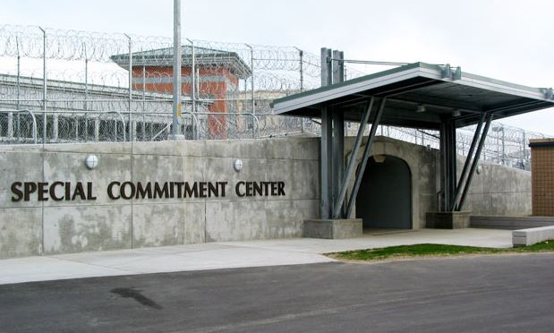
Special Commitment Center
The Department of Social and Health Services (DSHS) operates Special Commitment Center (SCC) programs that provide specialized mental health treatment for civilly committed sex offenders who have completed their prison sentences.

Slide 23
Community Notification Methods
Sex Offender Public Websites
Notification Flyers / Post Cards
Community Education Forums
Media Releases

Slide 24
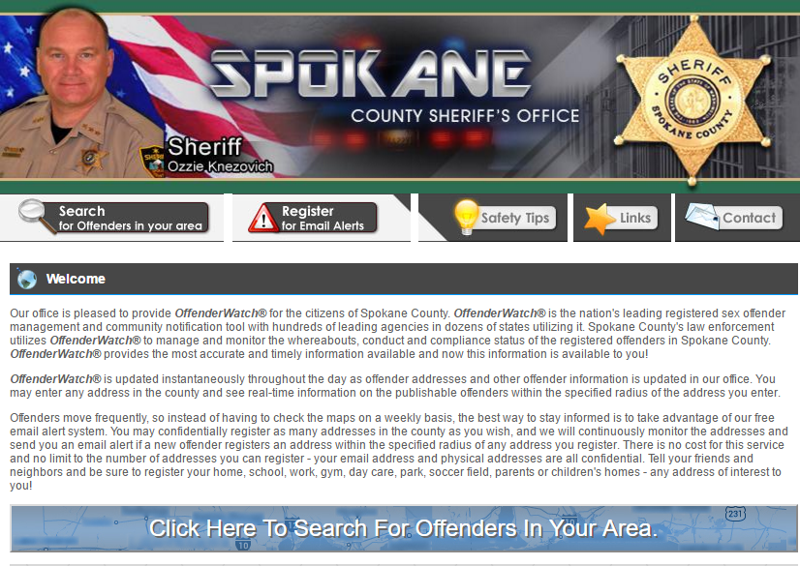
Sex Offender Public Websites
Washington State: www.sheriffalerts.com
National: www.nsopw.gov
  The WA website feeds directly into the National website.
Notes:
The website shall provide mapping capabilities that display the sex offender’s address by hundred block on a map. The website shall allow citizens to search for registered sex offenders within the state of Washington by county, zip code, last name and address by hundred block.

Slide 25
What’s on the Website?
On the web
Not on the web
Name
Relevant criminal convictions
Address by hundred block
Physical description
Photograph
Specific Victim Information
Level I Offenders*
Exact Addresses
Employment Details
Social Security #’s
Specific DOBs

Slide 26

Community Forums &
Media Releases
Community forums
Media releases
Education!
Education!
Education!
Print Media
Televised Media

Slide 27
Common Questions?
Can you make them leave? Offenders have the right to live where they choose unless it violates a condition of their Judgment and Sentence.
How close to schools or child care centers or parks can they live? Washington does not have residency restrictions unless it is a condition. Residency restrictions are not a protective factor.
How can I protect my family and myself? Be aware. Talk to you children about personal safety. Contact your local sexual assault agency for prevention information.
What can I do to protect myself and my family?
Community members should report to law enforcement or the offender’s Community Corrections Officer, if known, when they see the offender engaging in inappropriate behavior.

Slide 28
Address Verification
In accordance with RCW 9A.44.135 and 36.28A.230 address verifications are completed as follows:
  Level I sex offender – once a year
  Level II sex offender – twice a year
  Level III sex offender – quarterly
  Homeless offender – checks in weekly

Slide 29
Resources
Community Sexual Assault Programs
www.wasor.org
RSO Flyer – Contains links to help talk with your children and other resources
School counselors
Law enforcement

Slide 30
Offender Specific Information

Slide 31
Questions from the
Community?

Slide 32
Conclusion
Please share what you have learned tonight with others.
The purpose of these meetings is to empower you by providing information about sex offenders and about personal safety.
There are resources in the community to assist you.

Slide 33
Contact Info:

